Slide 1
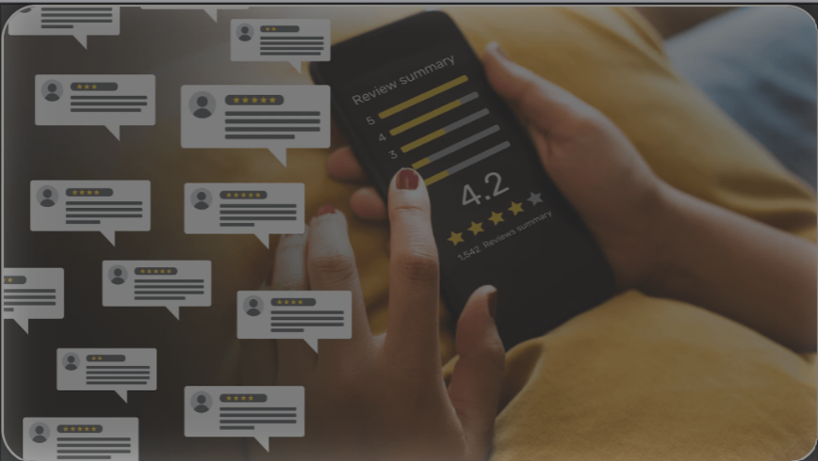
Restaurant Review Website
Team 1
MENUMATCH

Slide 2
Team Members
Team Leader - Dirgha Jivani.
Requirement Leader - Roshni Dodhi.
Design and Implementation Leader - Anshul Raj.
Configuration Leader - Vignesh S.
Security Leader - Prayushi Khandelwal.
QA Leader - Jiho Cheon.
Design and Implementation Leader. - Pratyush Patel

Slide 3
Overview of Iteration 2
Iteration Goals:
Transitioned data source from Google API to third party application for more comprehensive review data.
Established backend infrastructure with Flask.
Implemented essential user stories for registration and secure access.
Focus Areas:
Improved data quality and backend functionality.
Sub-teams for Iteration 2:
Frontend :- Dirgha, Pratyush, Vignesh
Backend :- Anshul, Jiho, Prayushi, Roshni
Notes:
In this second iteration, we focused on enhancing our restaurant review platform by transitioning from Google API to a more robust third-party application, enriching our review data to better cater to specific dietary needs. We established a solid backend infrastructure using Flask, which has significantly improved scalability and data management. Key advancements were made in implementing secure user registration and access, directly impacting our platform's reliability and user trust. The project was effectively segmented between our dedicated sub-teams; Frontend, led by Dirgha, Pratyush, and Vignesh, focused on user interface improvements, while Backend, managed by Anshul, Jiho, Prayushi, and myself, fortified backend operations. This collaborative effort has set a strong foundation for further enhancements and features in our upcoming iterations.

Slide 4
Data Source Transition
Previous Approach:
Used Google API to scrape restaurant review data.
Limitation: Google API restricted to 5 reviews per restaurant..
Current Approach with Third Party Application:
This application allows access to all reviews per restaurant.
We have now close to 300 restaurants with total of around 500,000 reviews.
Application used for fetching reviews: Github Link
Retraining Model:
Collected more data.
Trained model to extract information tailored to user dietary needs based on new data.
Notes:
In response to the limitations posed by the Google API, which restricted us to only five reviews per restaurant, we transitioned to a third-party application that grants access to all reviews available per restaurant. This significant change has expanded our database to include around 300 restaurants with a total of approximately 500,000 reviews, accessed via a GitHub link (insert link here). Leveraging this expansive dataset, we retrained our model to more accurately extract and analyze information tailored to specific dietary needs, vastly improving the personalization and effectiveness of our restaurant recommendations for users with particular dietary preferences.

Slide 5
Progress Made in Iteration 2
New Backend Setup:
Integrated Flask for backend functionality, creating a foundation for handling data and user management.
User Stories Implemented:
User registration and secure login.
Authorized access for protected routes.
List all available restaurants
Get details of a particular restaurant
List all reviews
Get details of a review
Refactoring and Code Quality:
Refactored database setup and model structure to support new data source and backend requirements.

Slide 6
Features and User Stories in Iteration 2
User Stories Covered:
User Registration:
As a user, I can register on the platform to access and personalize dietary reviews.
User Login and Authentication:
As a user, I can log in securely to use protected features.
Authorization for Protected Routes:
Only authorized users can access certain areas of the application.
List all available restaurants
As a user, I want to view a list of all available restaurants to explore options.
As a user, I want to see detailed information about a restaurant to decide if it meets my needs.
List all reviews
As a user, I want to view all reviews to gain insights into various restaurants.
As a user, I want to see specific details of a review to understand individual experiences.

Slide 7
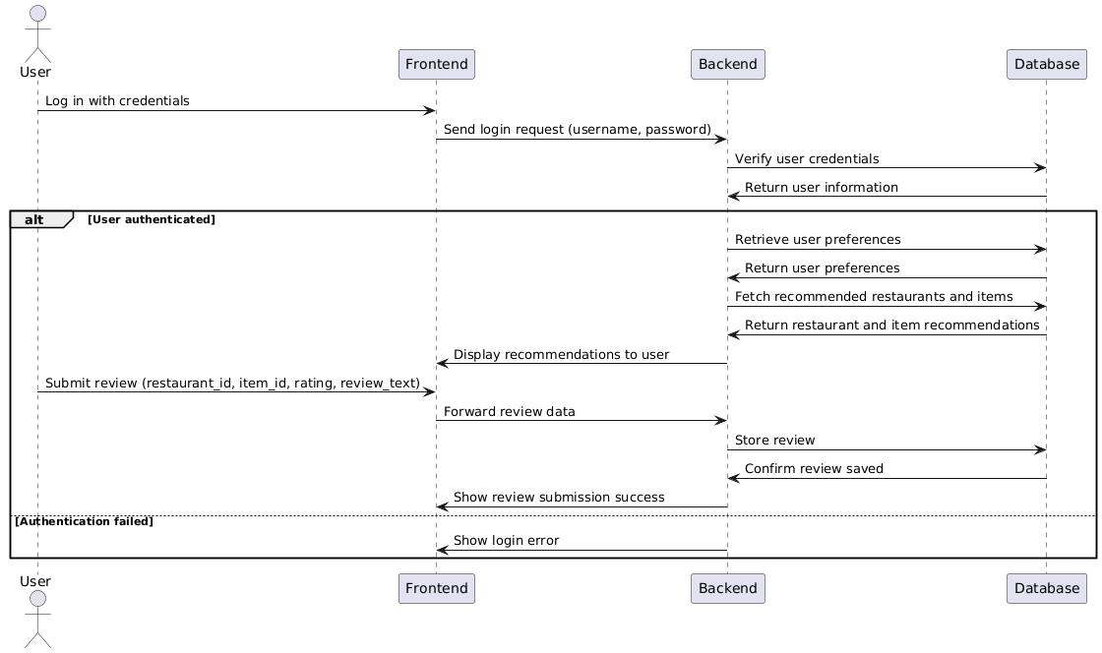

Slide 8
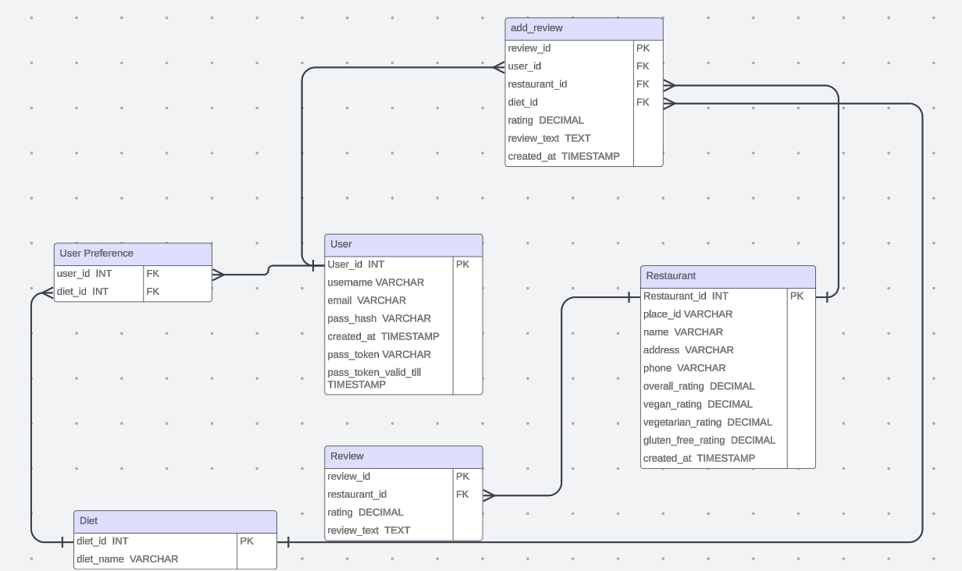

Slide 9
Front End Design
Requirements for MenuMatch
Frontend Framework:
React
Purpose: Provides a responsive, component-based structure that supports the MenuMatch project’s dynamic requirements, such as real-time restaurant search and filtering.
Features Used: Components for reusable UI elements (e.g., search bar, restaurant cards), state management to handle user inputs and data fetched from APIs, and efficient DOM updates for a smooth user experience.
Styling Framework:
Tailwind CSS
Purpose: Allows rapid UI development with pre-designed utility classes, ensuring a consistent look and feel throughout the app.
Project-Specific Benefits:
Enables quick customization for a clean, user-friendly design that aligns with the theme of a food discovery platform.

Slide 10
Routing:
React Router DOM
Purpose: Provides smooth, client-side navigation between different pages without refreshing the whole page, maintaining the flow of a single-page application (SPA).
Project-Specific Benefits:
Enables intuitive navigation between key pages, such as Home, About, Map (for restaurant locations), and Login/Signup.
Supports route-based code splitting, loading only the necessary components for each page to improve app performance and load times.
Backend and APIs:
Google Maps API (Planned)
Purpose: Fetches location data and displays interactive maps, allowing users to see nearby restaurants on a map.
Project-Specific Benefits:
Integrates geographic data to enhance the user experience by allowing location-based restaurant searches and visualizing restaurant locations.

Slide 11
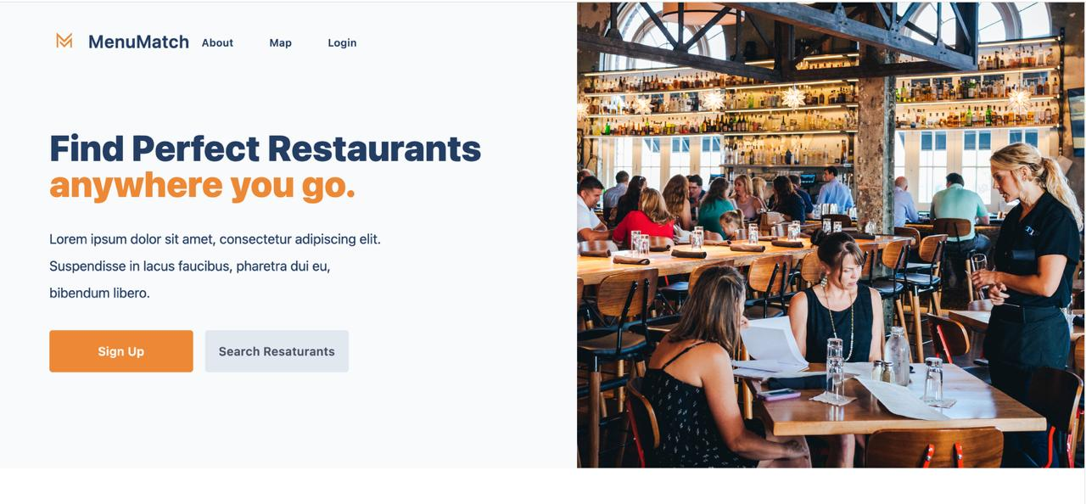
This page shows a landing page design for the "MenuMatch" website, Here are two key aspects:
Main Heading and Call to Action: The left side of the page features a bold, attention-grabbing headline, "Find Perfect Restaurants anywhere you go." It’s followed by a call to action with "Sign Up" and "Search Restaurants" buttons, encouraging users to engage right away.
Inviting Visual Background: The right side displays a cozy restaurant scene with people dining, which visually reinforces the purpose of the site and gives users a sense of what they can expect – discovering restaurants in a comfortable, inviting atmosphere.
This layout effectively combines text and visuals to attract users' interest and encourage exploration.

Slide 12
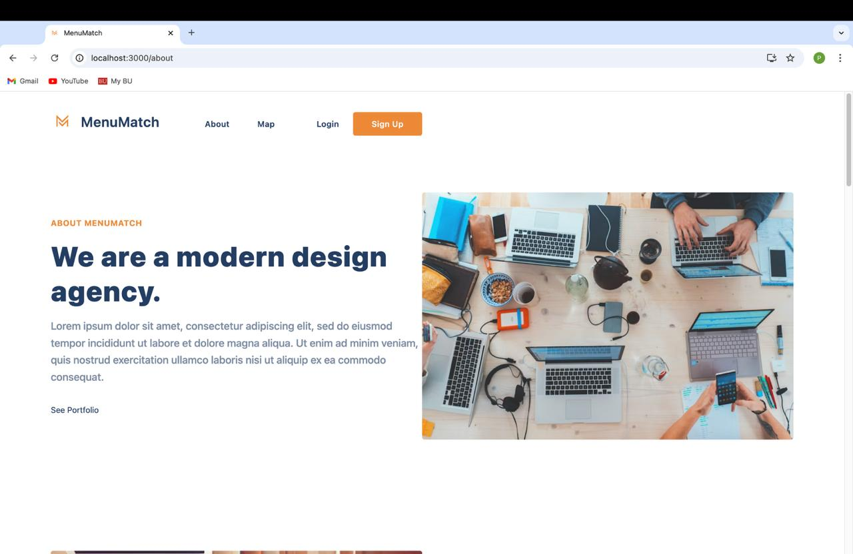
This is the About page for the MenuMatch project, designed to give users an overview of the platform. Here are some key elements in this page:
Visual Design:
A large image of a collaborative workspace with multiple devices reinforces the concept of a tech-driven, modern service. This design choice aligns with MenuMatch’s aim to leverage technology for restaurant discovery.
The clean, minimalistic layout, enhanced by Tailwind CSS, gives the page a professional look and makes information easy to read.
Navigation and Calls to Action:
The top navigation includes links like About, Map, Login, and Sign Up, providing quick access to key sections. The "Sign Up" button is highlighted in orange to encourage user engagement.
There's a "See Portfolio" link, which might redirect users to a showcase of the project’s features or past projects, though it could be repurposed to direct users to learn more about MenuMatch’s unique offerings.

Slide 13
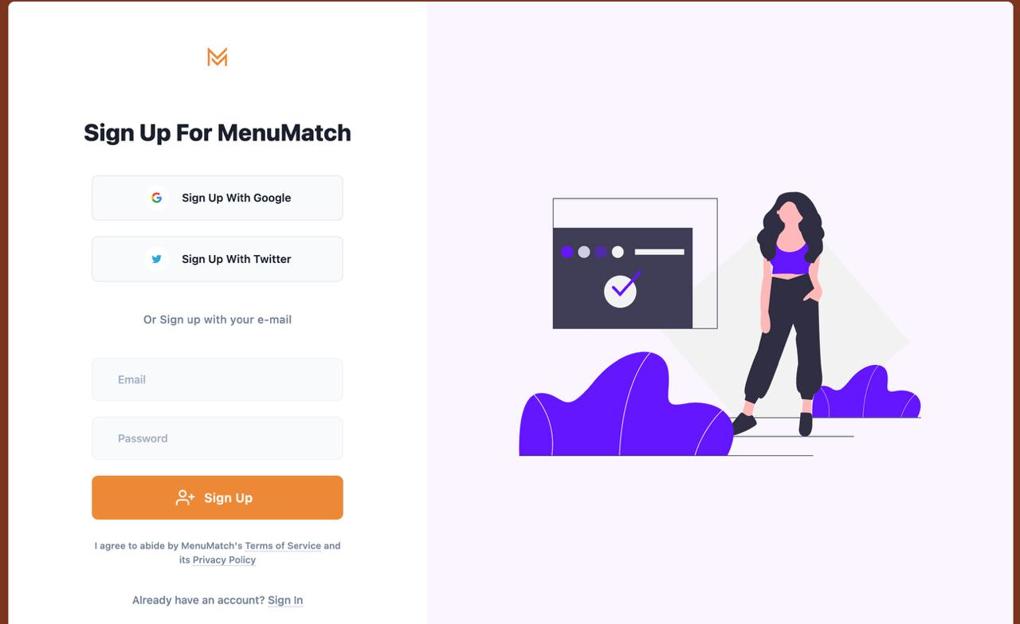
This is the Sign Up page for the MenuMatch project. Here’s a breakdown of its design and features:
Sign-Up Options:
Users are given multiple ways to sign up, with social media integration options such as:
Sign Up with Google
Sign Up with Twitter
These options make the process quick and convenient, appealing to users who prefer streamlined sign-ups without filling out additional information.
Email Sign-Up Form:
Users can also sign up with their email by entering an Email and Password.
The Sign Up button is highlighted in orange, drawing attention as the primary call-to-action on the page.
Alternative Sign-In Option:
A link at the bottom invites users who already have an account to "Sign In," creating a seamless experience for returning users.

Slide 14
Code Structure and Architecture Mapping
Backend with Flask:
Established routes for user registration and login.
Secure access setup for protected routes.
Database Schema:
Updated schema for new reviews.
Class Structure:
Key classes: User for registration/login, Review for dish-specific ratings, Diet for dietary category linking, Restaurant for details of a restaurant.
Architecture Alignment:
Backend organized to support user management, data retrieval, and dietary filtering.

Slide 15
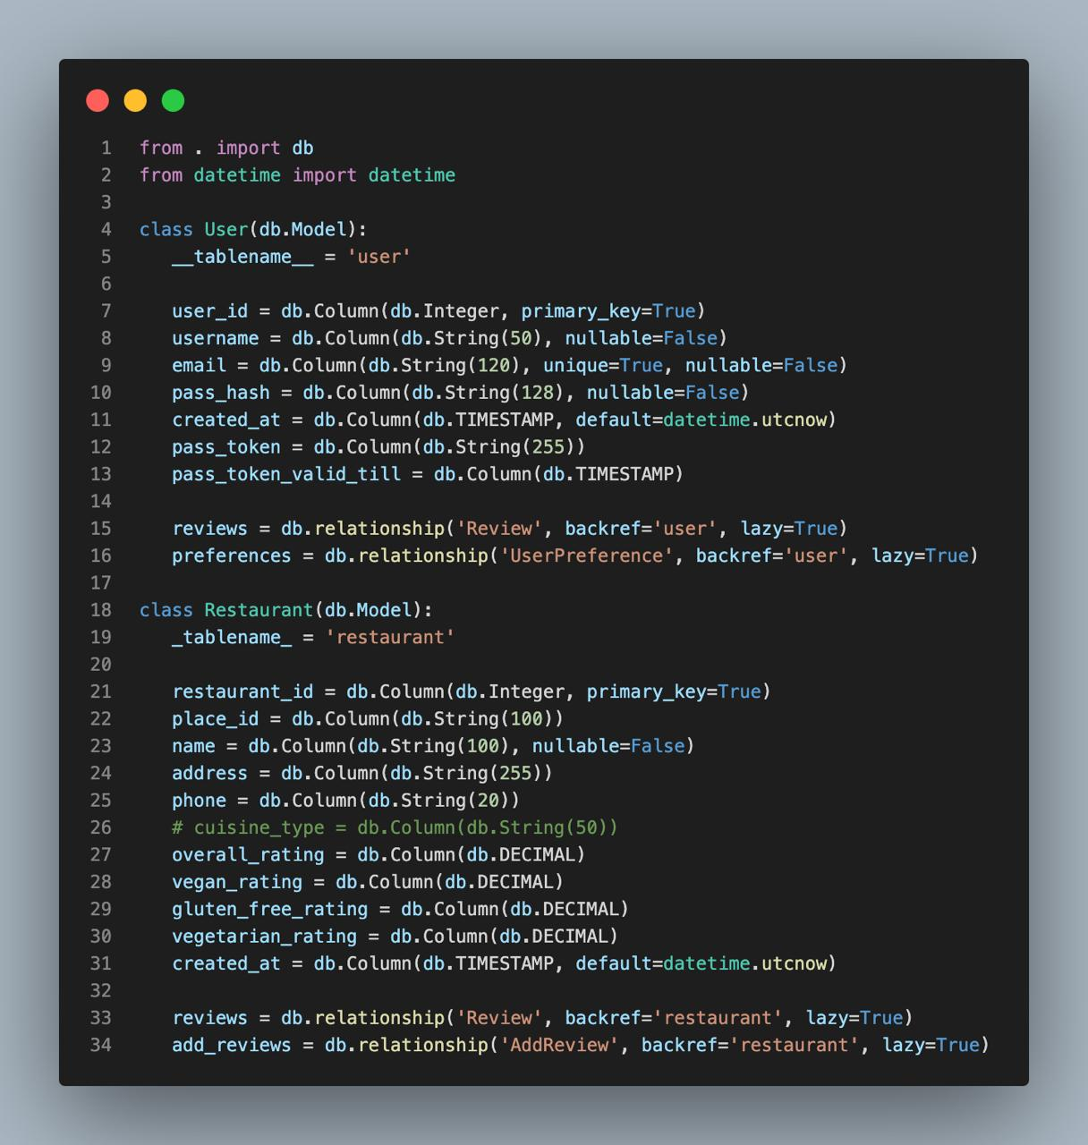
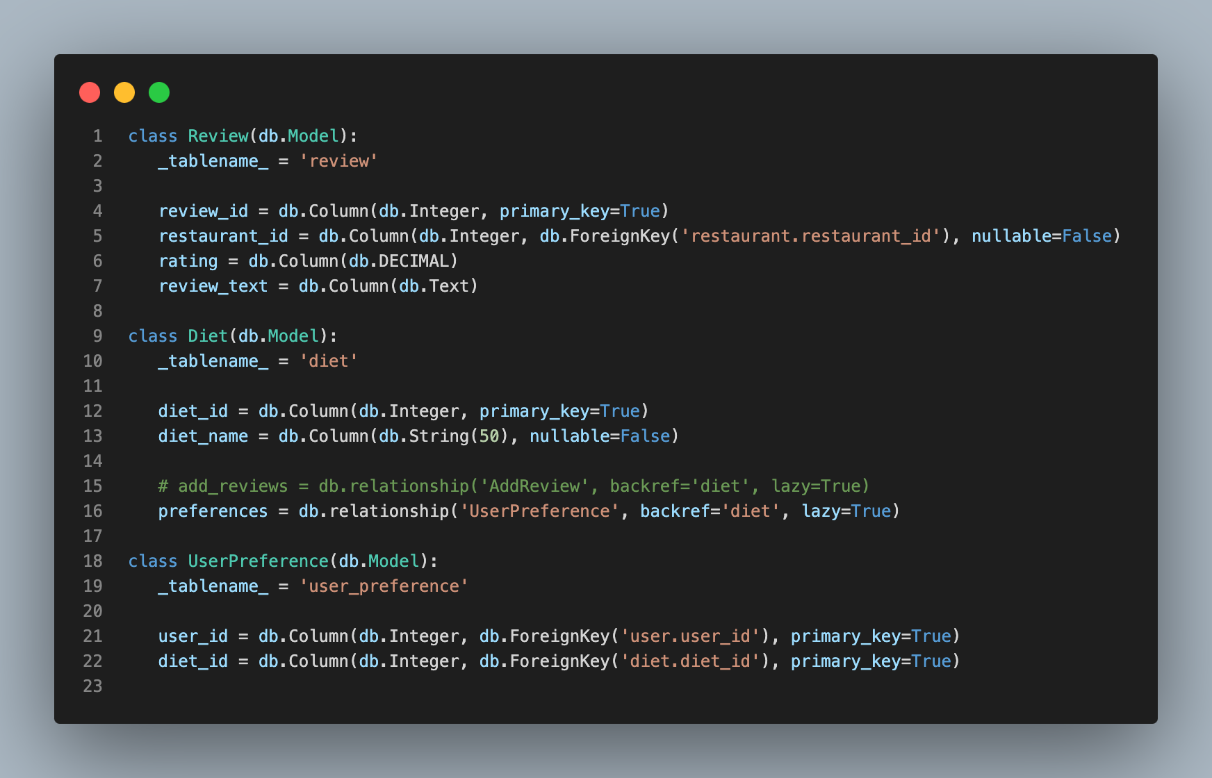

Slide 16
API Endpoints implemented
1. Authentication Endpoints (/api/auth):
Signup: POST /signup – Register a new user
Login: POST /login – Authenticate and obtain JWT token
Logout: POST /logout – Invalidate JWT token
2. User Management (/api/users):
Get Users: GET / – List all users
Get User by ID: GET /<user_id> – Retrieve a specific user
3. Restaurant Management (/api/restaurants):
Get Restaurants: GET / – List all restaurants
Get Restaurant by ID: GET /details/<restaurant_id>
Load: GET / – Load restaurants from data files
Clear: GET /clear-all
4. Review Management (/api/reviews):
Get Reviews: GET / – List all reviews
Get Review by ID: GET /<review_id>
Load: GET / – Load reviews from data files
Clear: GET /clear-all

Slide 17
Implementation Emphasis: Code Quality and Refactoring
Data Source Refactoring:
Adjusted model and schema to handle Third Party data format.
Improved data handling for reviews and ratings linked to specific restaurants.
Code Quality:
Pre-Commit Hooks: Enforced coding standards before committing.
Peer Code Reviews: Enhanced consistency and reliability.

Slide 18
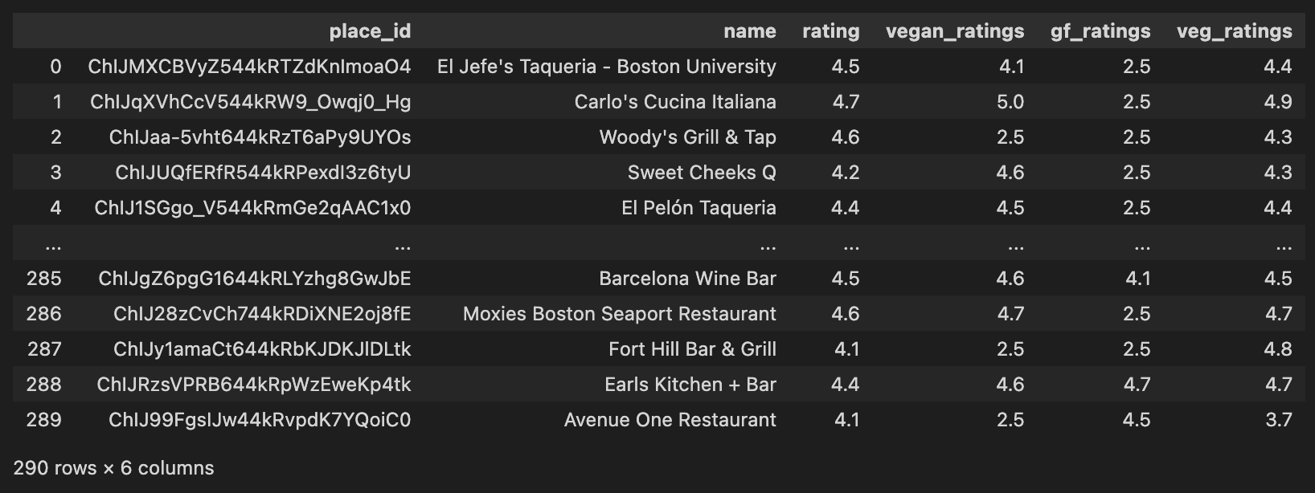
Data Source Refactoring

Slide 19
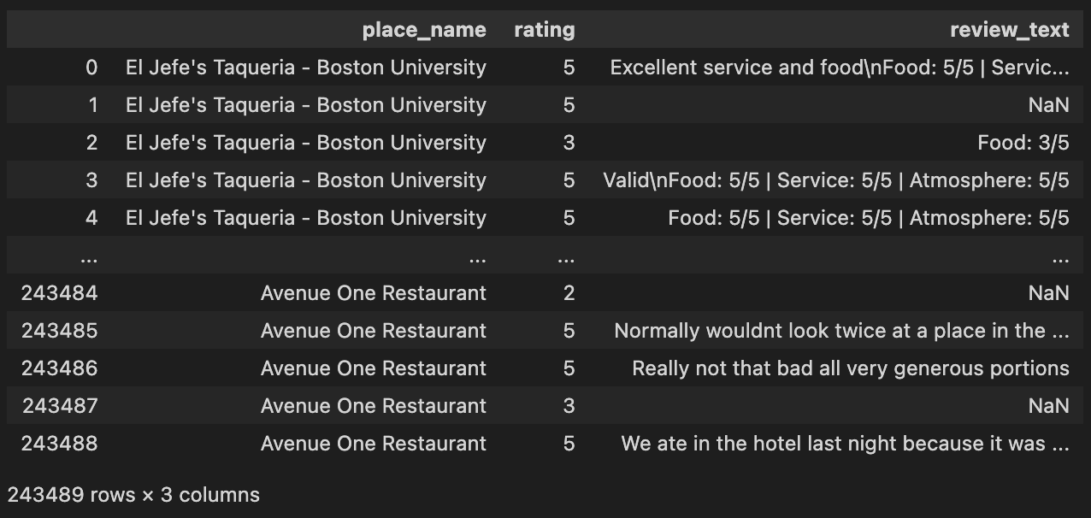
Data Source Refactoring

Slide 20
Dietary Preference Rating from Google Reviews
Extract Relevant Reviews
Use Natural Language Processing (NLP) to identify reviews that mention dietary keywords (e.g., "vegan," "gluten-free").
Analyze Sentiment
Apply sentiment analysis using a pre-trained model (e.g., VADER from nltk or DistilBERT from transformers).
Scores are converted to a 1-5 rating scale.
Calculate Ratings
Aggregate sentiment scores to generate overall ratings for each dietary preference.

Slide 21
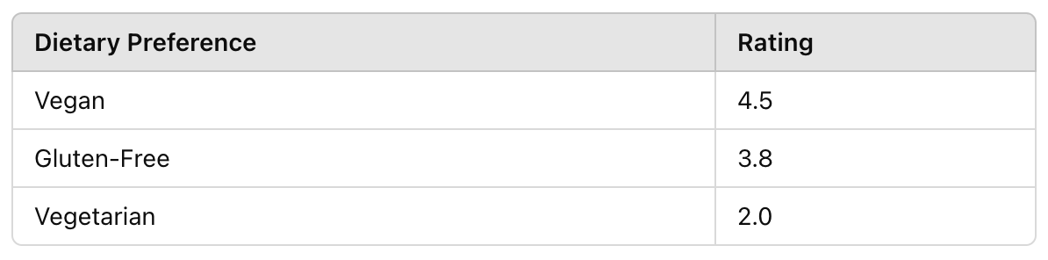
Dietary Preference Rating from Google Reviews
Example Output
Next Steps
Improve Sentiment Accuracy: Use fine-tuned models for restaurant reviews.
Handle Mixed Sentiments: Account for reviews mentioning multiple preferences.

Slide 22
Testing and Quality Assurance
Testing Types:
Unit tests for user registration, login, and route protection.
API testing using POSTMAN to verify api-endpoints
Code Review Process:
Peer reviews for each new feature.
Automated tests in CI pipeline for quality checks.
Bug Fixes:
Fixed data format issues from Third Party data ingestion.
Resolved issues in user login and protected route logic.
Notes:
Rigorous Testing Focus: Emphasizing comprehensive testing to ensure robust application performance and enhance user satisfaction.
Unit Testing Practices: Conducting unit tests on critical functions such as user registration, login, and route protection to maintain code integrity.
API Testing with POSTMAN: Utilizing POSTMAN for detailed API testing to confirm that all endpoints operate correctly and efficiently.
Peer Review Integration: Implementing a thorough peer review process for every new feature, integrated into our CI pipeline for ongoing quality assurance.
Recent Bug Resolutions: Addressing and fixing significant issues including data format errors from new data sources and logical errors in user login and route protections.
Quality Impact: These enhancements have markedly improved platform reliability and user experience, ensuring stability and security.

Slide 23
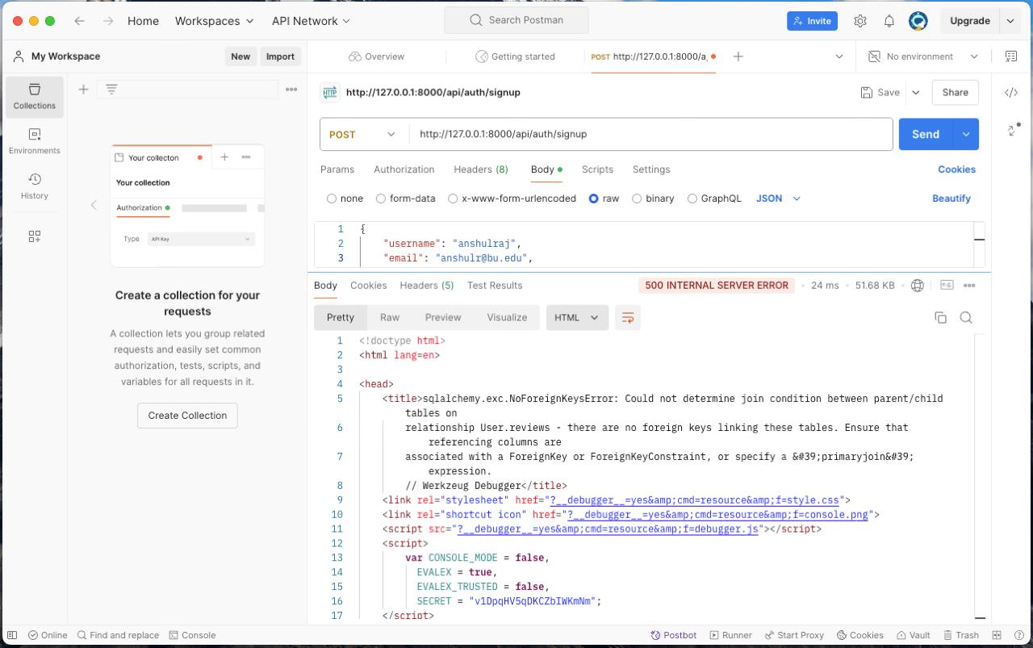

Slide 24
Refactoring and Bug Fixes
Data Refactoring:
Updated data extraction and processing for dish-specific reviews.
Bug Resolutions:
Improved secure route handling.
Fixed integration issues between new data format and application model.
Notes:
Significant Enhancements: Implemented major updates in data extraction and processing focusing on dish-specific reviews to improve the accuracy and relevance of the information provided.
Refined Data Handling: Updated methods to enhance the clarity and usefulness of review data, catering specifically to dietary preferences and restrictions.
Security Improvements: Enhanced security measures in route handling to ensure robust protection of user data during platform interactions.
Bug Fixes and Integrations: Addressed and resolved key integration challenges between the new data formats and our application model, enhancing system compatibility.
Platform Stability and Functionality: These refinements have not only stabilized our platform but also boosted its overall functionality, leading to a smoother and more secure user experience.

Slide 25
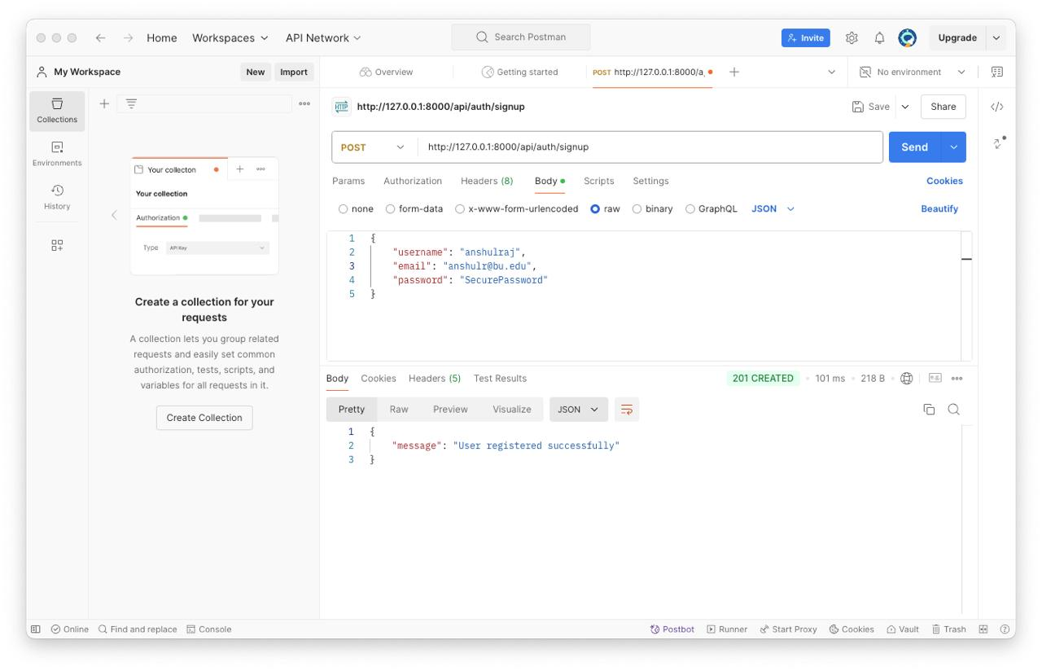

Slide 26
Challenges and Lessons Learned
Challenges:
Transitioning to a new data source and adapting schema.
Managing secure access for protected routes.
Lessons Learned:
Flexibility to adapt to better data sources improved platform quality.
Importance of continuous testing with each backend adjustment.
Notes:
Challenges with Data Transition: Encountered significant challenges in transitioning to a third-party data source, necessitating major adjustments to our data schema for compatibility.
Secure Access Management: Faced complexities in managing secure access for protected routes, crucial for ensuring user privacy and data security.
Lesson on Flexibility: Learned the value of adaptability in choosing superior data sources, which has significantly improved our platform’s quality and user satisfaction.
Continuous Testing Importance: Recognized the critical need for continuous testing, particularly after backend adjustments, to promptly identify and resolve issues.
Impact on Future Strategies: These lessons are instrumental in shaping our future development strategies and maintaining high standards as our platform continues to evolve.
we are still working on automated testing

Slide 27
Next Steps for Future Iterations
Further Goals:
Expand dietary filtering options with new data.
New Feature: Implement functionality for users to submit their own reviews and ratings for restaurants, allowing for more personalized, community-driven insights.
Performance Optimization:
Improve backend efficiency for handling larger datasets.
Improve models efficiency for achieving better results.
Add secure ssl access to the website.
Notes:
Expansion of Dietary Filtering Options: We aim to broaden our dietary filtering capabilities by integrating new data sources, enhancing users' ability to make well-informed dining decisions.
User-Generated Content: Planning to introduce a feature allowing users to submit their own reviews and ratings, fostering a more personalized and community-centric platform.
Backend Optimization: Focused on optimizing our backend processes to manage larger datasets more efficiently and boost the performance of our models for quicker, more accurate outcomes.
Security Enhancements: We will implement SSL access across the platform to guarantee the highest security level for user data.
Overall Platform Enhancement: These initiatives are designed not only to improve the user experience but also to strengthen the technical foundation and robustness of our platform.

